Slide 1
Simple and Multiple Linear Regression
Tim Pengajaran
Mata Kuliah Machine Learning
Jurusan Teknologi Informasi Tahun 2021

Slide 2
Disclaimer
This presentation material, including examples, images, references are provided for informational and explanation assistance only
The names of actual products and companies mentioned here in, if any, may be the trademarks of their respective owners
Credits shall be given to the images taken from the open-source and cannot be used for promotional activities

Slide 3
Outline Simple Regression
What is Regression and Linear Regression?
Evaluating the Fitness of the Model with a Cost Function
Solving Ordinary Least Square for Simple Linear Regression
Evaluating the Model

Slide 4
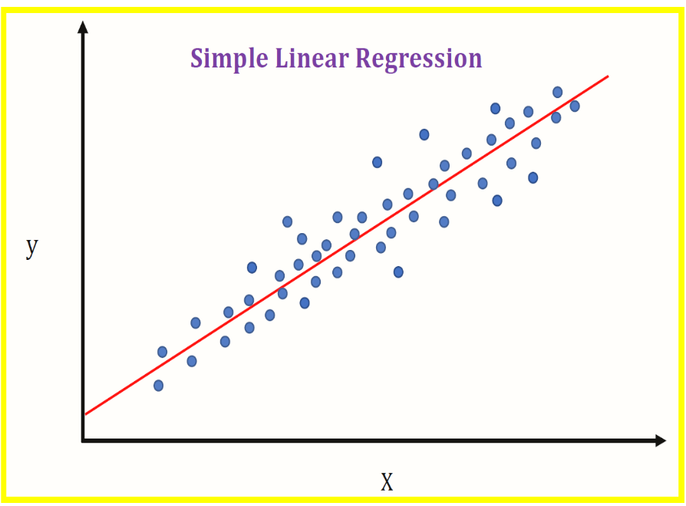
What is Regression and Linear Regression?
Regression is to predict the value of a continuous response variable.
Linear Regression is to model the relationship between two variables by fitting a linear equation to observed data.
One variable is considered to be an explanatory variable, and the other is considered to be a dependent variable.
Linear Regression in this lecture is called as Simple Linear Regression or SLR

Slide 5
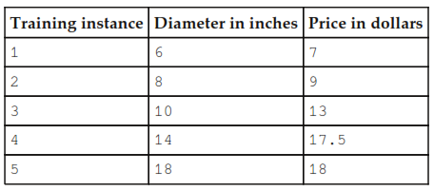
Example
A model of the relationship between the size of a pizza and its price with training data as follows.
Create a simple linear regression code to see their relationship.

Slide 6
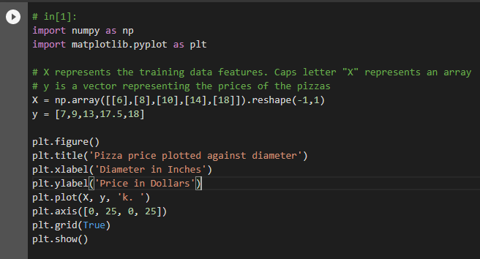
The Code

Slide 7
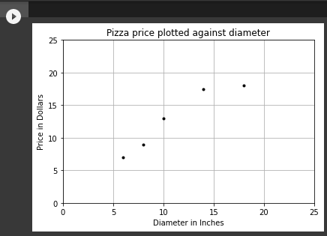
The Plot
As the diameter of the pizza increases, so the pizza price.
This gives intuition that the plot can be used as a predictor model.

Slide 8
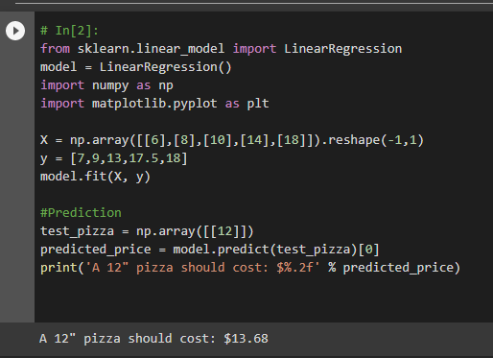
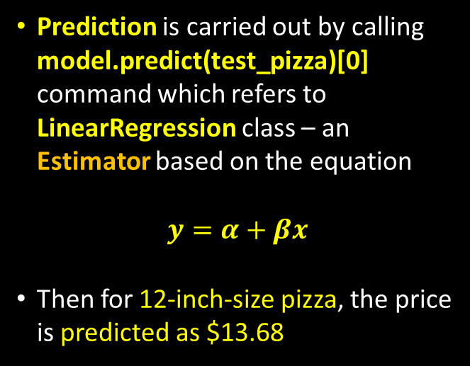
Prediction using SLR
Prediction is carried out by calling model.predict(test_pizza)[0] command which refers to LinearRegression class – an Estimator based on the equation
$$y=α+βx$$
Then for 12-inch-size pizza, the price is predicted as $13.68

Slide 9
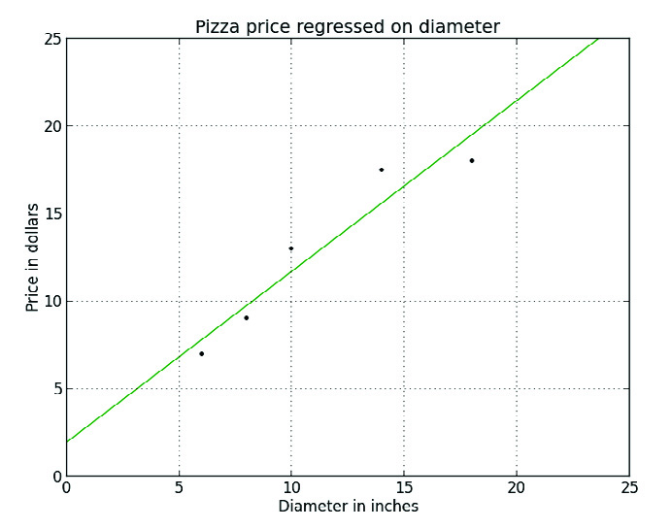
The Essential of SLR
SLR assumes that a linear relationship exists between the response variable and the explanatory variable through a linear surface called a hyperplane – a subspace that has one dimension less than the ambient space that contains it.
There is one dimension for the response variable and another dimension for the explanatory variable, for a total of two dimensions.
A hyperplane with one dimension is a line.
Hyperplane

Slide 10
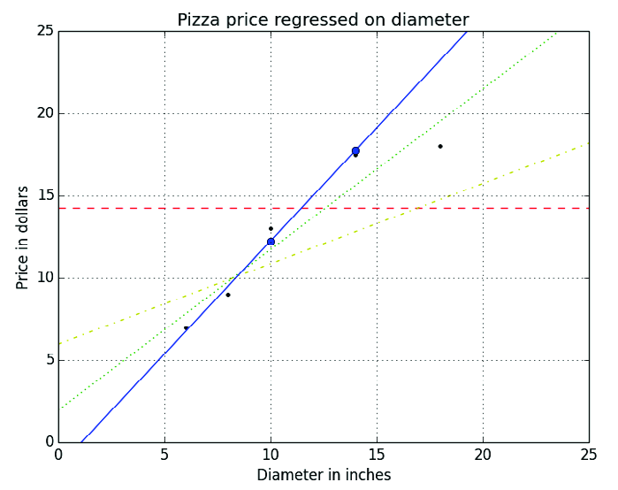
Ordinary Least Square
Using training data to learn the values of the parameters for SLR that produce the best fitting model.
Estimates the relationship between one or more independent variables and a dependent variable by minimizing the sum of the squares in the difference between the observed and predicted values of the dependent variable configured as a straight line.
The difference between prediction and reality (observed) is called as Error – the vertical distance between a real data point and the regression line.
Also called as Linear Least Square.

Slide 11
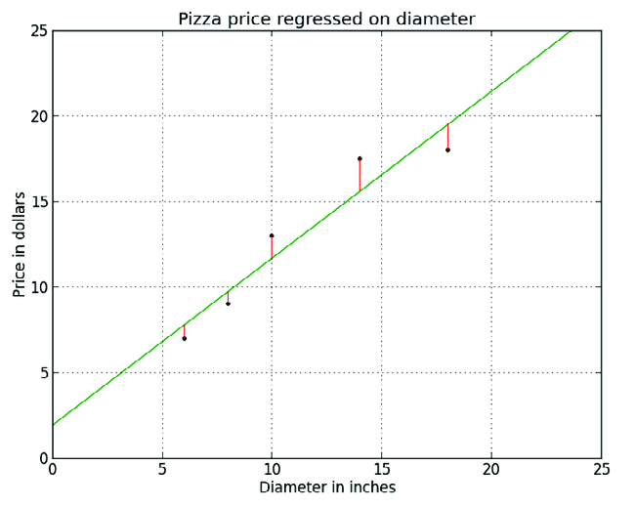
Evaluating the Fitness of the Model with a Cost Function
A cost function, also called a loss function, is used to define and measure the error of a model, or a measure of how wrong the model is in terms of its ability to estimate the relationship between X and y.
The differences between the prices predicted by the model and the observed prices of the pizzas in the training set are called residuals, or training errors.
The differences between the predicted and observed values in the test data are called prediction errors, or test errors.

Slide 12
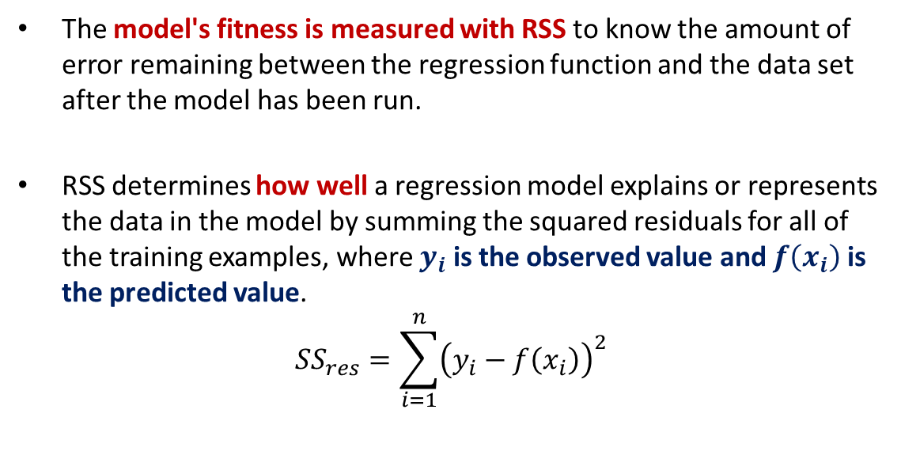
The Residual Sum of Squares (RSS)
The model's fitness is measured with RSS to know the amount of error remaining between the regression function and the data set after the model has been run.
RSS determines how well a regression model explains or represents the data in the model by summing the squared residuals for all of the training examples, where $y_{i}$ is the observed value and $f\left(x_{i}\right)$is the predicted value.
$$SS_{res}=\sum_{i=1}^{n}{{\left(y_{i}−f\left(x_{i}\right)\right)}^{2}}$$

Slide 13
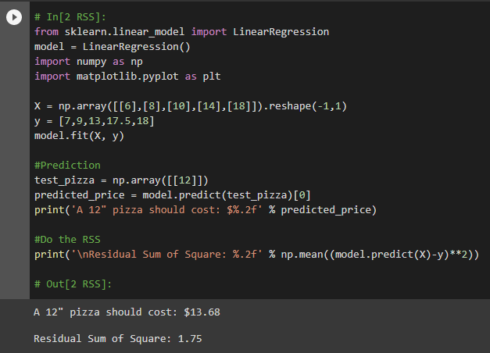
RSS Computation

Slide 14

Solving OLS for SLR
Recalling $y=α+βx$ where $α$ is constant or intercept which measures the valuen where the regression line crosses the y-axis, while $β$ is slope coefficent which measures the steepnes of the regression line.
The goal is to solve for the values of $β$ and $α$ to minimize the cost function – minimize the predictor error.

Slide 15
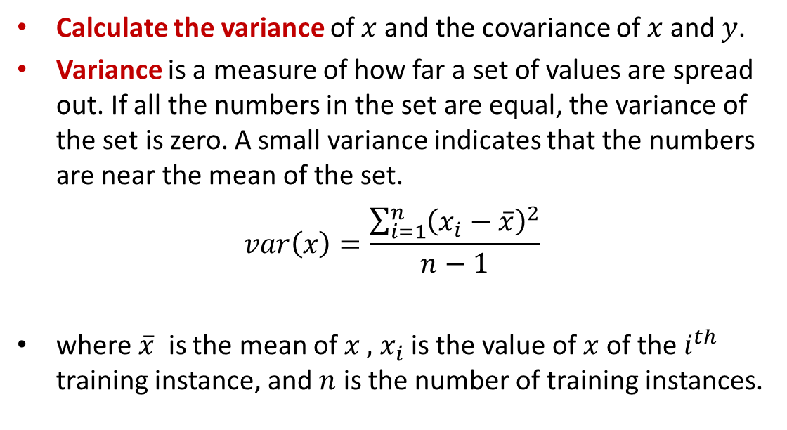

Solving for $β$
Calculate the variance of $x$ and the covariance of $x$ and $y$.
Variance is a measure of how far a set of values are spread out. If all the numbers in the set are equal, the variance of the set is zero. A small variance indicates that the numbers are near the mean of the set.
$$var\left(x\right)=\frac{\sum_{i=1}^{n}{{\left(x_{i}−\overline{x}\right)}^{2}}}{n−1}$$
where $\overline{x}$ is the mean of $x ,$ $x_{i}$is the value of $x$of the $i^{th}$ training instance, and $n$ is the number of training instances.

Slide 16
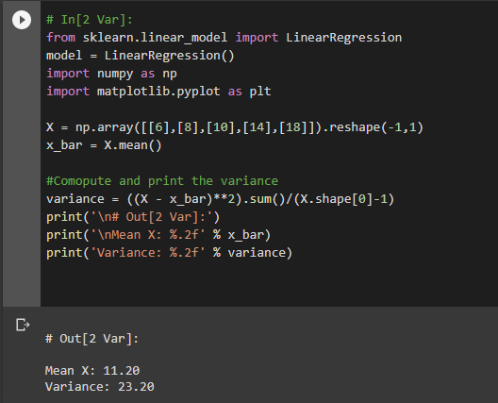

Solving for $β$ – Computing the Variance

Slide 17
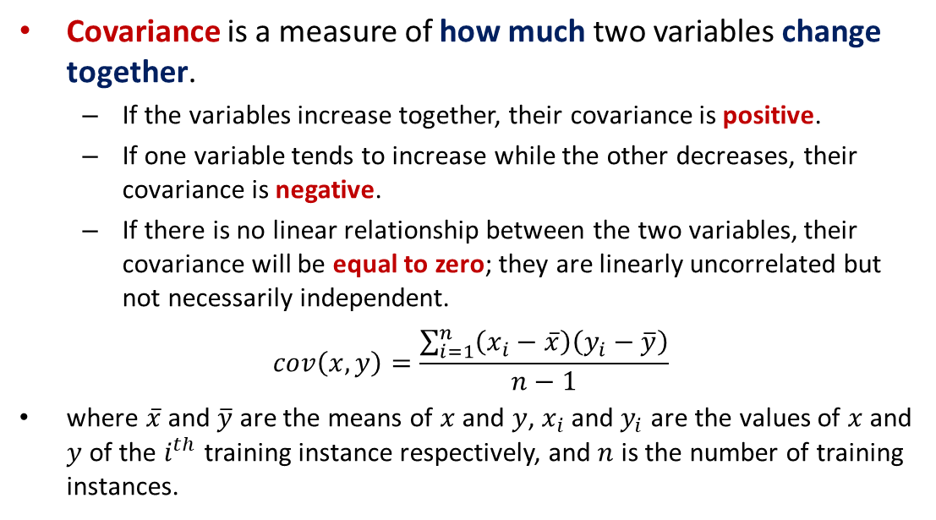

Solving for $β$ – Computing the Covariance
Covariance is a measure of how much two variables change together.
If the variables increase together, their covariance is positive.
If one variable tends to increase while the other decreases, their covariance is negative.
If there is no linear relationship between the two variables, their covariance will be equal to zero; they are linearly uncorrelated but not necessarily independent.
$$cov\left(x,y\right)=\frac{\sum_{i=1}^{n}{\left(x_{i}−\overline{x}\right)\left(y_{i}−\overline{y}\right)}}{n−1}$$
where $\overline{x}$ and $\overline{y}$ are the means of $x$ and $y$, $x_{i}$and $y_{i}$ are the values of $x$and $y$of the $i^{th}$ training instance respectively, and $n$ is the number of training instances.

Slide 18
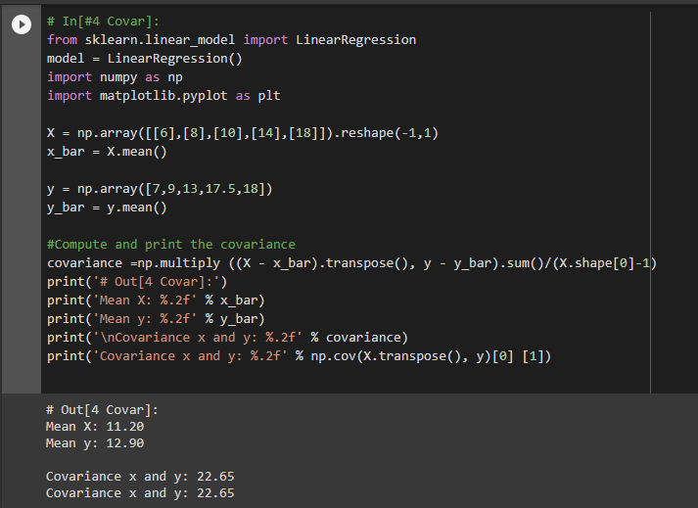
Computing the Covariance

Slide 19
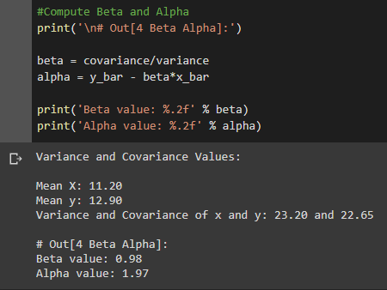

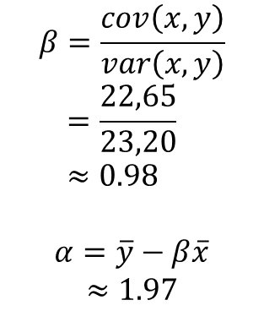
Solving $β$ and $α$
$$β=\frac{cov\left(x,y\right)}{var\left(x,y\right)} \\ =\frac{22,65}{23,20} \\ ≈0.98$$
$$α=\overline{y}−β\overline{x}$$ $≈1.97$

Slide 20
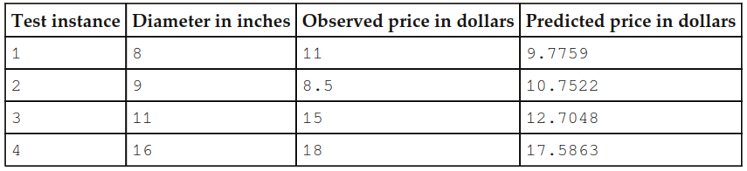
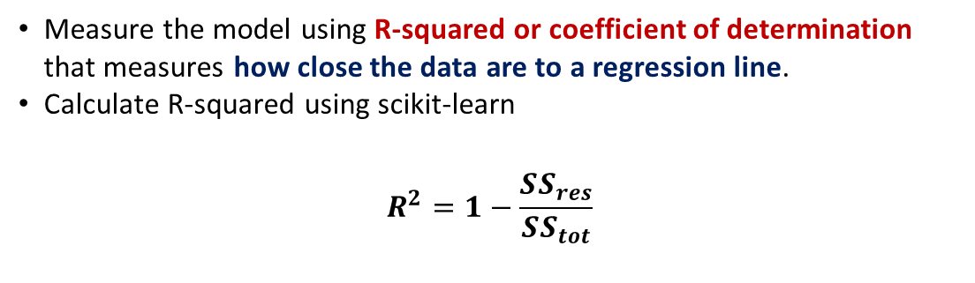
Evaluating the Model
Measure the model using R-squared or coefficient of determination that measures how close the data are to a regression line.
Calculate R-squared using scikit-learn
$$R^{2}=1−\frac{SS_{res}}{SS_{tot}}$$

Slide 21
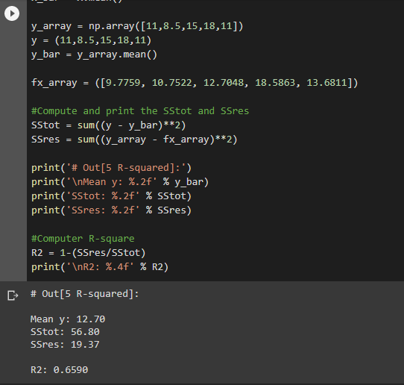
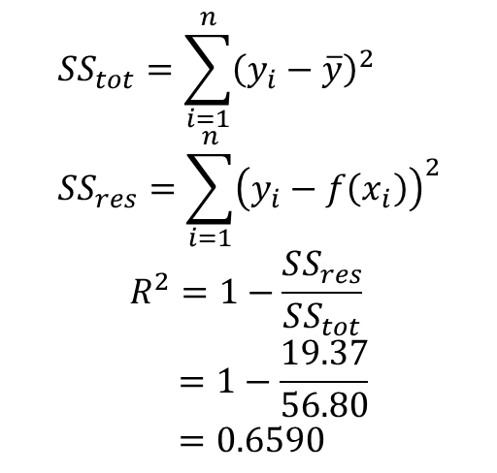
Computing R-squared
$$SS_{tot}=\sum_{i=1}^{n}{{\left(y_{i}−\overline{y}\right)}^{2}} \\ SS_{res}=\sum_{i=1}^{n}{{\left(y_{i}−f\left(x_{i}\right)\right)}^{2}}$$
$$R^{2}=1−\frac{SS_{res}}{SS_{tot}} \\ =1−\frac{19.37}{56.80} \\ =0.6590$$

Slide 22
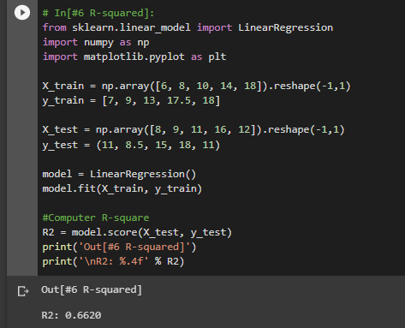
R-squared Computation Alternative

Slide 23
Multiple Linear Regression

Slide 24
Outline Multiple Linear Regression
What is Multiple Linear Regression?
Introducing Polynomial Regression
Regularization
Exploring the Data, Fitting and Evaluating the Model
Gradient Descent

Slide 25
Multiple Linear Regression
A generalization of simple linear regression that regresses a continuous response variable onto multiple features.
Uses a coefficient for each of an arbitrary number of explanatory variables.

Slide 26
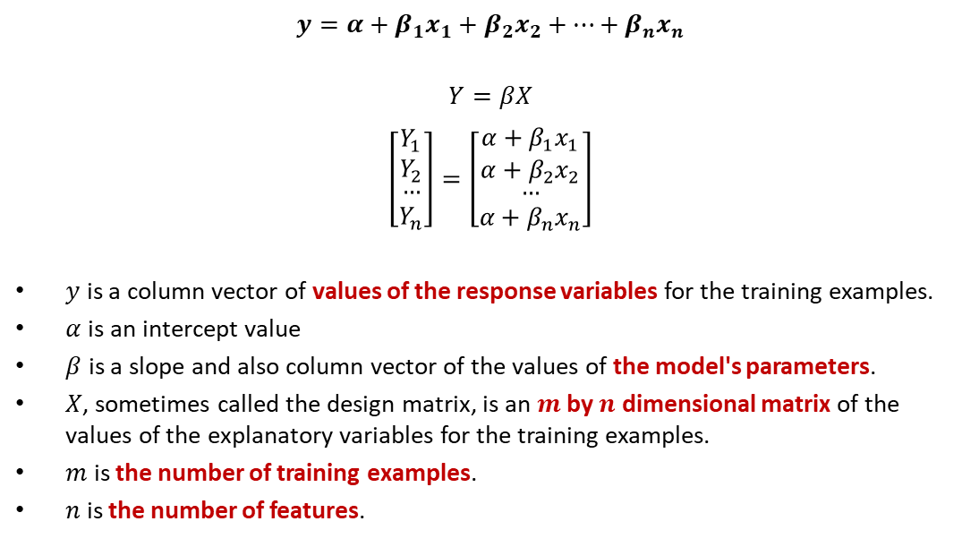
Multiple Linear Regression
$$y=α+β_{1}x_{1}+β_{2}x_{2}+…+β_{n}x_{n}$$
$$Y=βX$$
$$\left[\begin{matrix}Y_{1} \\ Y_{2} \\ \begin{aligned}… \\ Y_{n}\end{aligned}\end{matrix}\right]=\left[\begin{matrix}α+β_{1}x_{1} \\ α+β_{2}x_{2} \\ \begin{aligned}… \\ {α+β}_{n}x_{n}\end{aligned}\end{matrix}\right]$$
$y$ is a column vector of values of the response variables for the training examples.
$α$is an intercept value
$β$ is a slope and also column vector of the values of the model's parameters.
$X$, sometimes called the design matrix, is an $m$ by $n$ dimensional matrix of the values of the explanatory variables for the training examples.
$m$ is the number of training examples.
$n$ is the number of features.

Slide 27
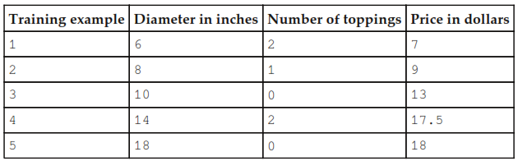
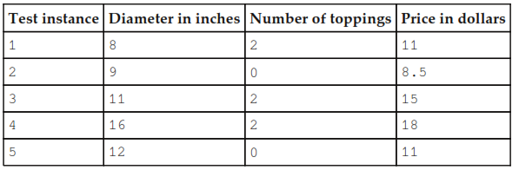
Example
Test Set
Training Set

Slide 28
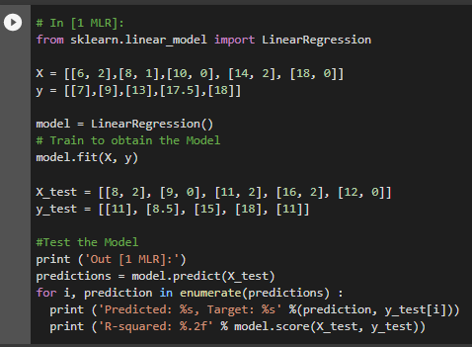
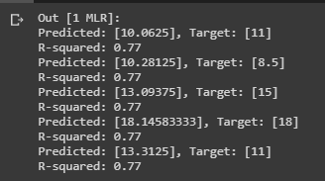
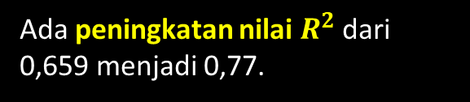
Prediction Results
Ada peningkatan nilai $R^{2}$ dari 0,659 menjadi 0,77.

Slide 29
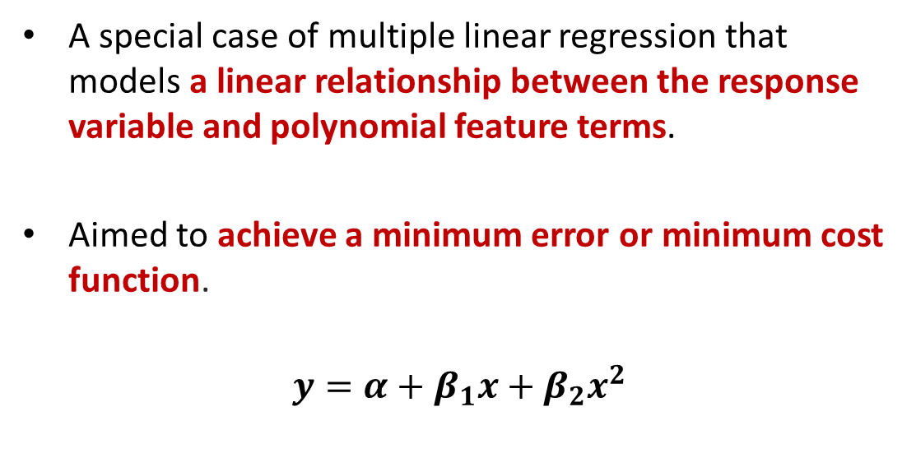
Polynomial Regression
A special case of multiple linear regression that models a linear relationship between the response variable and polynomial feature terms.
Aimed to achieve a minimum error or minimum cost function.
$$y=α+β_{1}x+β_{2}x^{2}$$

Slide 30
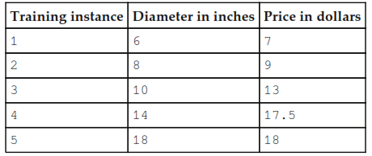
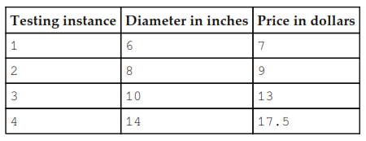
Example
Test Set
Training Set

Slide 31
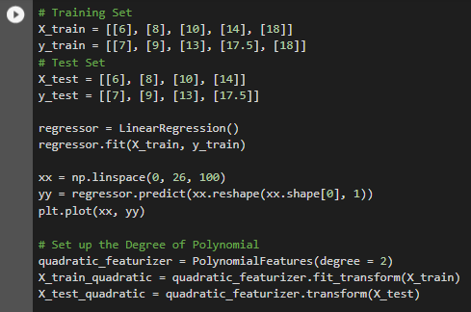
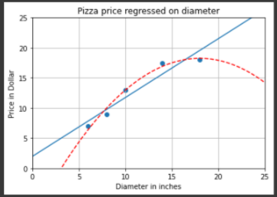
Prediction Results
Prediction using 2th-degree Polynomial

Slide 32
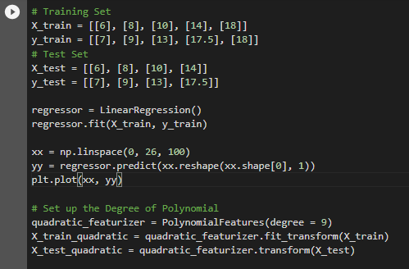
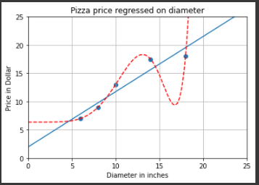

Prediction Results
Prediction using 9th-degree Polynomial

Slide 33
Problem
Polynomial Regression is an extremely complex model that fits the training data exactly, but fails to approximate the real relationship.
This problem is called overfitting.
The Price prediction is unrealistic faced to the reality

Slide 34
Regularization
A collection of techniques that can be used to prevent overfitting.
Adds information, often in the form of a penalty against complexity, to a problem.
Attempts to find the simplest model that explains the data.

Slide 35
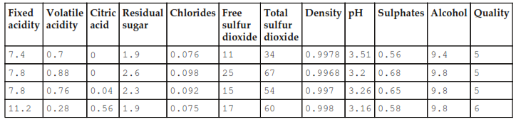
Exercise Exploring Data and Model Fitting and Evaluation

Slide 36
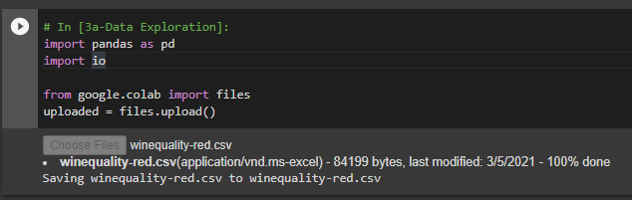
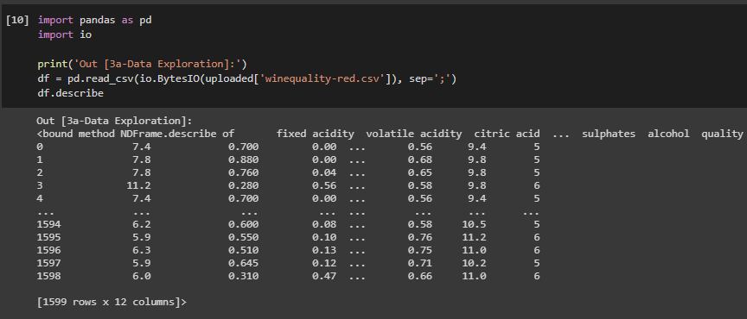
Upload File to Google Colab

Slide 37
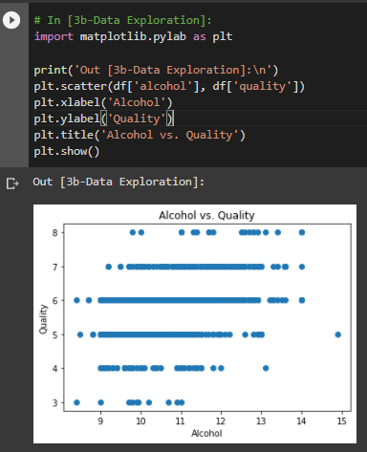
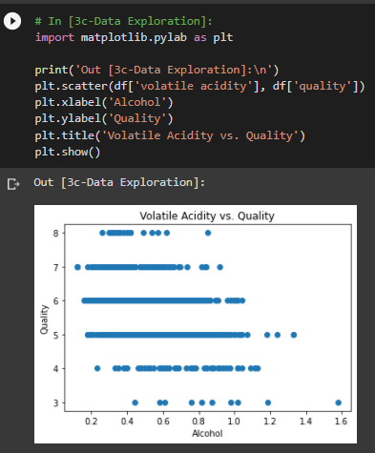
Results of Data Exploration

Slide 38
Model Fitting and Evaluation
train_test_split() function partitions randomly the data into training and test sets.
The proportions of the data for both partitions can be specified using keyword arguments, train_test_split(X, y, test_size = 0.25).
By default, 25% of the data is assigned to the test set.
Trained the model, and evaluated it on the test set.

Slide 39
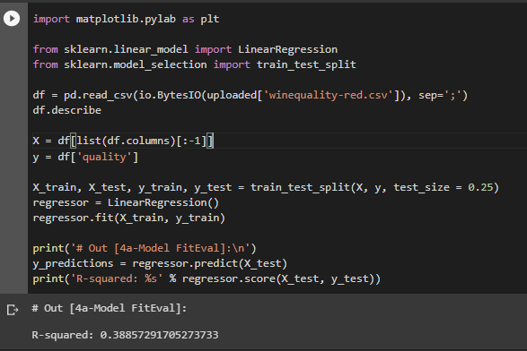
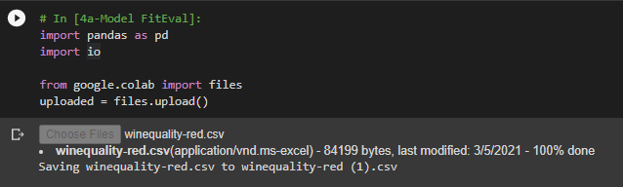
Example FitEvalModel

Slide 40
Cross Validating the Model
The cross_val_score() helper function allows us to easily perform cross validation using the provided data and estimator.
Specified five-fold cross validation using the keyword argument, cv = 5.
Each instance will be randomly assigned to one of five partitions.
Each partition will be used to train and test the model

Slide 41
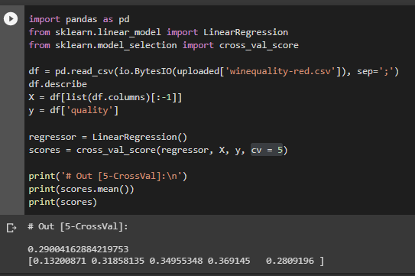
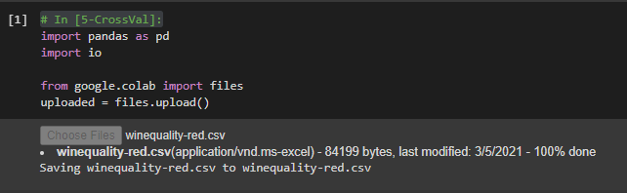
Example CrossValModel

Slide 42
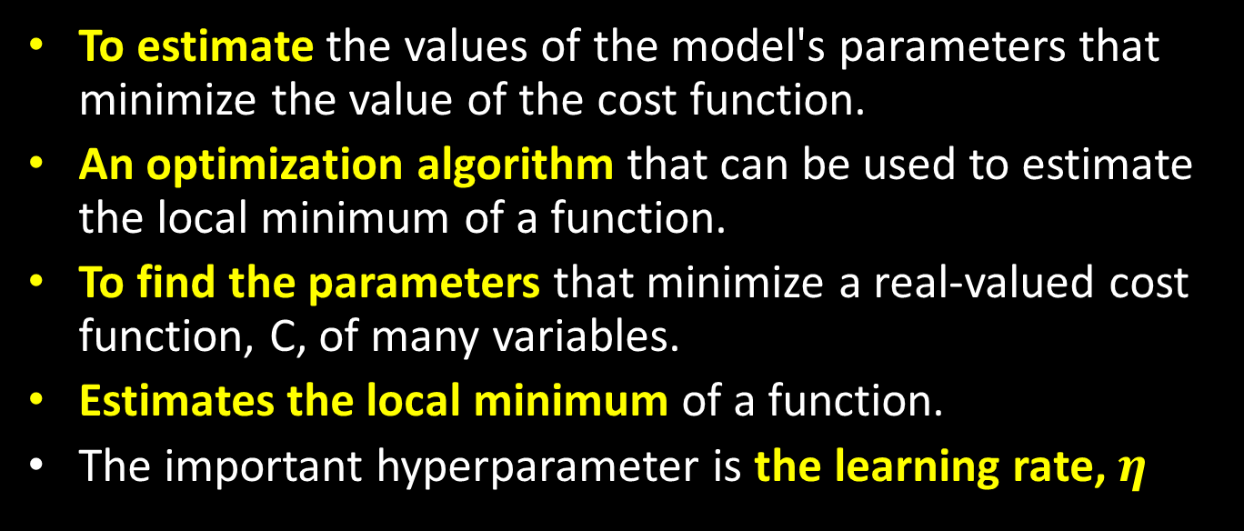
Gradient Descent
To estimate the values of the model's parameters that minimize the value of the cost function.
An optimization algorithm that can be used to estimate the local minimum of a function.
To find the parameters that minimize a real-valued cost function, C, of many variables.
Estimates the local minimum of a function.
The important hyperparameter is the learning rate, $η$

Slide 43

Simple Mathematics of Gradient Descent
$$ΔC≈\frac{∂C}{∂v_{1}}∆v_{1}+\frac{∂C}{∂v_{2}}∆v_{2}$$
$\frac{∂C}{∂v_{1}}$ is the partial derivative of C with respect to $v_{1}$.
$\frac{∂C}{∂v_{2}}$ is the partial derivative of C with respect to $v_{2}$.
$∆v_{1}$is the change in the value of $v_{1}$.
$∆v_{2}$is the change in the value of $v_{2}$.
Taking a small step $∆v_{1}$ in the $v_{1}$ direction and $∆v_{2}$ in the $v_{2}$ direction results in a small change in the value of C, $ΔC$.

Slide 44
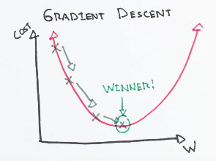
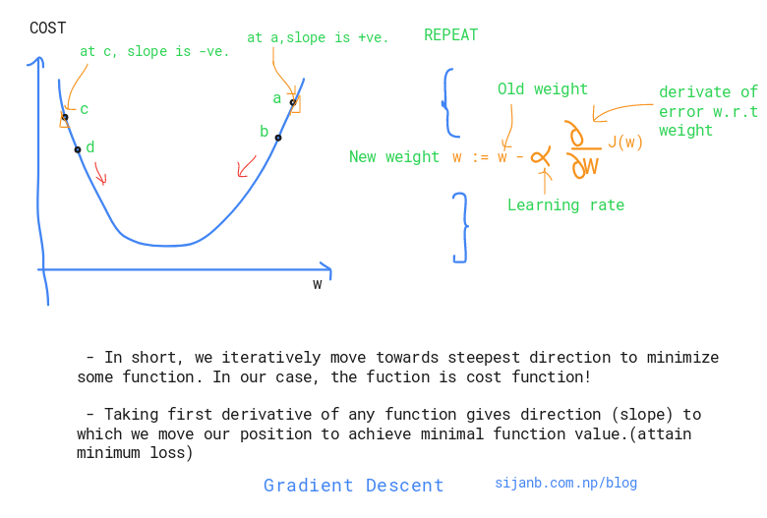
Gradient Descent
Gradient descent is sometimes described by the analogy of a blindfolded person who is trying to find her way from somewhere on a mountainside to the lowest point of the valley.

Slide 45
Types of Gradient Descent
Batch Gradient Descent
Uses all of the training instances to update the model parameters in each iteration.
A deterministic algorithm, and will produce the same parameter values given the same training set.
Stochastic Gradient Descent (SGD)
Updates the parameters using only a single training instance in each iteration.
The training instance is usually selected randomly.
Preferred when there are hundreds of thousands of training instances or more.

Slide 46

The Contribution of Learning Rate
$$∆v=−η∇C$$
$$∇C={\left(\frac{∂C}{∂v_{1}},\frac{∂C}{∂v_{2}}\right)}^{T}$$
$∇C$ is the gradient vector of C.
The minus sign will ensure that $ΔC$ negative to ensure that the variables vector take a step in the direction of the steepest decline.
The learning rate controls how fast the gradient descent to converge.
The smaller the learning rate, the longer the time needs to converge.
The higher the learning rate, the higher the possibility to oscillate around the optimal values.

Slide 47


Example of the Use of SGD
Cross validation folds can be set up by manipulating argument cv = n where n is the number of folds.

Slide 48
Thank You for Today
Always Keep Your Spirit!

